Slide 1
8086 Microprocessor
Dr. Manju Khurana
Assistant Professor, CSED
TIET, Patiala
manju.khurana@thapar.edu

Slide 2
Architecture
BIU is responsible for:-
It handles transfer of data and addresses between the processor and memory/IO devices.
It computes and sends out addresses, Fetches instruction codes, stores fetched instruction codes in a first in first out register called a Queue, Reads data from memory and I/O devices, Writes data to memory and I/O devices.
EU is responsible for:-
EU receives opcode of an instruction from the queue, decodes it and then executes it.
While EU is decoding an instruction or executing an instruction, the BIU fetches instruction codes from the memory and stores them in the queue.
The BIU and EU operate in parallel independently.
This type of overlapped operation of the functional units of a microprocessor is called pipelining.

Slide 3
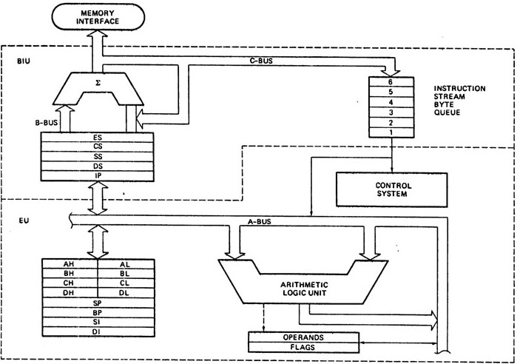
Architecture
Notes:
Upper circuit calculate Physical address = Segment address*10h+offset

Slide 4
Segment Registers
There are four segment registers in Intel 8086:
Code Segment Register (CS)
Data Segment Register (DS)
Stack Segment Register (SS)
Extra Segment Register (ES)

Slide 5
Segment Registers
In 8086, memory is divided into four segments:
Code Segment
Data Segment
Stack Segment
Extra Segment

Slide 6
Segment Registers
A segment register points to the starting address of a memory segment.
For e.g.:
The code segment register points to the starting address of the code segment.
The data segment register points to the starting address of the data segment, and so on.
The maximum capacity of a segment may be up to 64 KB.

Slide 7
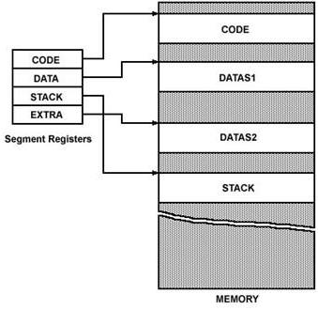
Segment Registers

Slide 8
Segment Registers
The instructions of 8086 specify 16-bit address.
But the actual physical addresses are of 20-bit.
Therefore, they are calculated using the contents of the segment registers and the effective memory address.

Slide 9
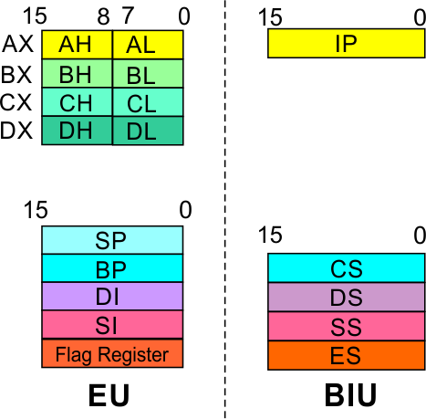
Architecture
8086 Microprocessor
Bus Interface Unit (BIU)
Segment
Registers
Code Segment Register
16-bit
CS contains the base or start of the current code segment; IP contains the distance or offset from this address to the next instruction byte to be fetched.
BIU computes the 20-bit physical address by logically shifting the contents of CS 4-bits to the left and then adding the 16-bit contents of IP.
That is, all instructions of a program are relative to the contents of the CS register multiplied by 16 and then offset is added provided by the IP.

Slide 10
Architecture
8086 Microprocessor
Bus Interface Unit (BIU)
Segment
Registers
Data Segment Register
16-bit
Hold data, variables and constants of program.
Points to the current data segment; operands for most instructions are fetched from this segment.
The 16-bit contents of the Source Index (SI) or Destination Index (DI) or a 16-bit displacement are used as offset for computing the 20-bit physical address.

Slide 11
Architecture
8086 Microprocessor
Bus Interface Unit (BIU)
Segment
Registers
Stack Segment Register
16-bit
Points to the current stack.
The 20-bit physical stack address is calculated from the Stack Segment (SS) and the Stack Pointer (SP) for stack instructions such as PUSH and POP.
In based addressing mode, the 20-bit physical stack address is calculated from the Stack segment (SS) and the Base Pointer (BP).

Slide 12
Architecture
8086 Microprocessor
Bus Interface Unit (BIU)
Segment
Registers
Extra Segment Register
16-bit
Points to the extra segment in which data (in excess of 64K pointed to by the DS) is stored.
String instructions use the ES and DI to determine the 20-bit physical address for the destination.

Slide 13
Architecture
8086 Microprocessor
Bus Interface Unit (BIU)
Segment
Registers
Instruction Pointer
16-bit
Always points to the next instruction to be executed within the currently executing code segment.
So, this register contains the 16-bit offset address pointing to the next instruction code within the 64Kb of the code segment area.
Its content is automatically incremented as the execution of the next instruction takes place.
The contents of the IP and Code Segment Register are used to compute the memory address of the instruction code to be fetched.
This is done during the Fetch Cycle.

Slide 14
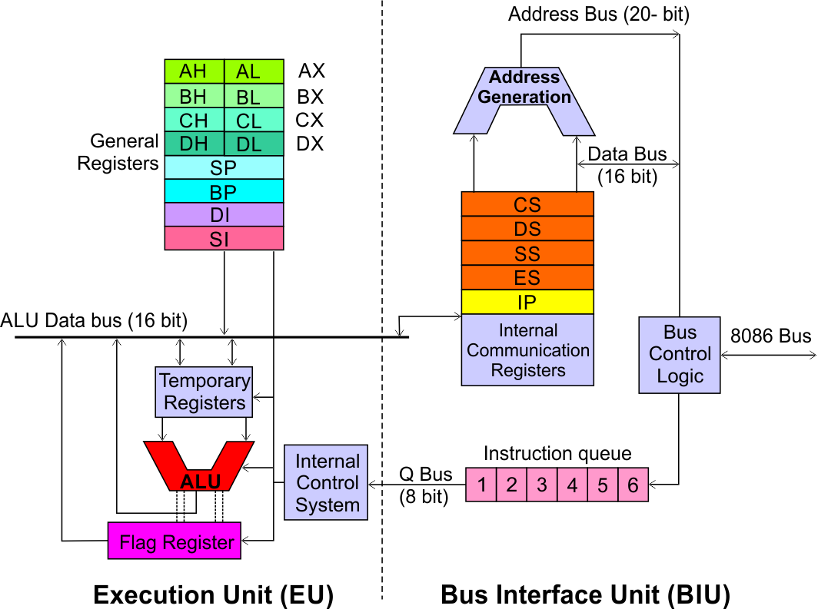
Architecture
8086 Microprocessor
Bus Interface Unit (BIU)
Instruction queue
A group of First-In-First-Out (FIFO) in which up to 6 bytes of instruction code are pre fetched from the memory ahead of time.
This is done in order to speed up the execution by overlapping instruction fetch with execution.
This mechanism is known as pipelining.

Slide 15
Architecture
8086 Microprocessor
Execution Unit (EU)
EU decodes and executes instructions.
A decoder in the EU control system translates instructions.
16-bit ALU for performing arithmetic and logic operation
Four general purpose registers(AX, BX, CX, DX);
Pointer registers (Stack Pointer, Base Pointer);
and
Index registers (Source Index, Destination Index) each of 16-bits
Some of the 16 bit registers can be used as two 8 bit registers as :
AX can be used as AH and AL
BX can be used as BH and BL
CX can be used as CH and CL
DX can be used as DH and DL

Slide 16
Architecture
8086 Microprocessor
Execution Unit (EU)
EU
Registers
Accumulator Register (AX)
Consists of two 8-bit registers AL and AH, which can be combined together and used as a 16-bit register AX.
AL in this case contains the low order byte of the word, and AH contains the high-order byte.
The I/O instructions use the AX or AL for inputting / outputting 16 or 8 bit data to or from an I/O port.
Multiplication and Division instructions also use the AX or AL.

Slide 17
Architecture
8086 Microprocessor
Execution Unit (EU)
EU
Registers
Base Register (BX)
Consists of two 8-bit registers BL and BH, which can be combined together and used as a 16-bit register BX.
BL in this case contains the low-order byte of the word, and BH contains the high-order byte.
This is the only general purpose register whose contents can be used for addressing the 8086 memory.
As a special purpose reg.,BX serve as a base register for the computation of mem. Address.
All memory references utilizing this register content for addressing use DS as the default segment register.

Slide 18
Architecture
8086 Microprocessor
Execution Unit (EU)
EU
Registers
Counter Register (CX)
Consists of two 8-bit registers CL and CH, which can be combined together and used as a 16-bit register CX.
When combined, CL register contains the low order byte of the word, and CH contains the high-order byte.
As a special purpose, used as a counter in case of multi-iteration instruction.
Instructions such as SHIFT, ROTATE and LOOP use the contents of CX as a counter.
Example:
The instruction LOOP START automatically decrements CX by 1 without affecting flags and will check if [CX] = 0.
If it is zero, 8086 executes the next instruction; otherwise the 8086 branches to the label START.

Slide 19
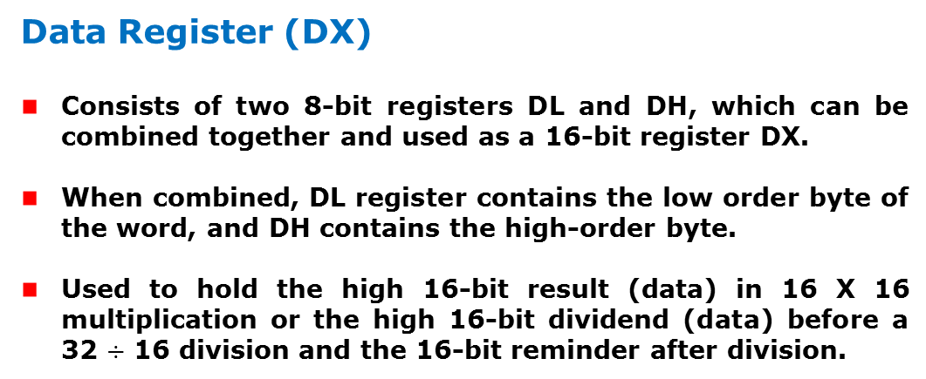
Architecture
8086 Microprocessor
Execution Unit (EU)
EU
Registers
Data Register (DX)
Consists of two 8-bit registers DL and DH, which can be combined together and used as a 16-bit register DX.
When combined, DL register contains the low order byte of the word, and DH contains the high-order byte.
Used to hold the high 16-bit result (data) in 16 X 16 multiplication or the high 16-bit dividend (data) before a 32 $÷$ 16 division and the 16-bit reminder after division.

Slide 20
Architecture
8086 Microprocessor
Execution Unit (EU)
EU
Registers
Stack Pointer (SP) and Base Pointer (BP)
SP and BP are used to access data in the stack segment.
SP is used as an offset from the current SS during execution of instructions that involve the stack segment in the external memory.
SP contents are automatically updated (incremented/ decremented) due to execution of a POP or PUSH instruction.
BP contains an offset address in the current SS, which is used by instructions utilizing the based addressing mode.

Slide 21
Architecture
8086 Microprocessor
Execution Unit (EU)
EU
Registers
Source Index (SI) and Destination Index (DI)
Used in indexed addressing.
Instructions that process data strings use the SI and DI registers together with DS and ES respectively in order to distinguish between the source and destination addresses.

Slide 22
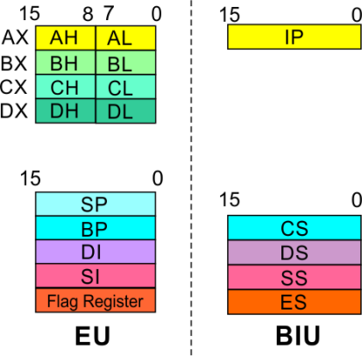
8086 Microprocessor
Architecture
8086 registers categorized into 4 groups
15 | 14 | 13 | 12 | 11 | 10 | 9 | 8 | 7 | 6 | 5 | 4 | 3 | 2 | 1 | 0
 |  |  |  | OF | DF | IF | TF | SF | ZF |  | AF |  | PF |  | CF
Sl.No. | Type | Register width | Name of register
1 | General purpose register | 16 bit | AX, BX, CX, DX
 |  | 8 bit | AL, AH, BL, BH, CL, CH, DL, DH
2 | Pointer register | 16 bit | SP, BP
3 | Index register | 16 bit | SI, DI
4 | Instruction Pointer | 16 bit | IP
5 | Segment register | 16 bit | CS, DS, SS, ES
6 | Flag (PSW) | 16 bit | Flag register

Slide 23
8086 Microprocessor
Architecture
Registers and Special Functions
Register | Name of the Register | Special Function
AX | 16-bit Accumulator | Stores the 16-bit results of arithmetic and logic operations
AL | 8-bit Accumulator | Stores the 8-bit results of arithmetic and logic operations
BX | Base register | Used to hold base value in base addressing mode to access memory data
CX | Count Register | Used to hold the count value in SHIFT, ROTATE and LOOP instructions
DX | Data Register | Used to hold data for multiplication and division operations
SP | Stack Pointer | Used to hold the offset address of top stack memory
BP | Base Pointer | Used to hold the base value in base addressing using SS register to access data from stack memory
SI | Source Index | Used to hold index value of source operand (data) for string instructions
DI | Data Index | Used to hold the index value of destination operand (data) for string operations

Slide 24
8086/88 internal registers 16 bits (2 bytes each)
AX, BX, CX and DX are two
bytes wide and each byte can
be accessed separately
These registers are used as
memory pointers.
Flags will be discussed later
Segment registers are used
as base address for a segment
in the 1 M byte of memory

Slide 25
Status Flags
8086 has 9 flags and they are divided into two categories:
Condition Flags
Control Flags

Slide 26
Status Flags
Following are the nine flags:
Condition Flags | Control Flags
Carry Flag | Trap Flag
Auxiliary Carry Flag | Interrupt Flag
Zero Flag | Directional Flag
Sign Flag
Parity Flag
Overflow Flag

Slide 27
Architecture(Flags)
8086 Microprocessor
Execution Unit (EU)
Auxiliary Carry Flag
This is set, if there is a carry from the lowest nibble, i.e, bit three during addition, or borrow for the lowest nibble, i.e, bit three, during subtraction.
Carry Flag
This flag is set, when there is a carry out of MSB in case of addition or a borrow in case of subtraction.
Flag Register
Sign Flag
This flag is set, when the result of any computation is negative
Zero Flag
This flag is set, if the result of the computation or comparison performed by an instruction is zero
Parity Flag
This flag is set to 1, if the lower byte of the result contains even number of 1’s ; for odd number of 1’s set to zero.
15 | 14 | 13 | 12 | 11 | 10 | 9 | 8 | 7 | 6 | 5 | 4 | 3 | 2 | 1 | 0
 |  |  |  | OF | DF | IF | TF | SF | ZF |  | AF |  | PF |  | CF
Over flow Flag
This flag is set, if an overflow occurs, i.e, if the result of a signed operation is large enough to accommodate in a destination register. The result is of more than 7-bits in size in case of 8-bit signed operation and more than 15-bits in size in case of 16-bit sign operations, then the overflow will be set.
Trap Flag
If this flag is set, the processor enters the single step execution mode by generating internal interrupts after the execution of each instruction
Direction Flag
This is used by string manipulation instructions. If this flag bit is ‘0’, the string is processed beginning from the lowest address to the highest address, i.e., auto incrementing mode. Otherwise, the string is processed from the highest address towards the lowest address, i.e., auto incrementing mode.
Interrupt Flag
Causes the 8086 to recognize external mask interrupts; clearing IF disables these interrupts.

Slide 28
Control Flags
Control flags are set or reset deliberately to control the operations of the execution unit. Control flags are as follows:
Trap Flag (TP):
It is used for single step control.
It allows user to execute one instruction of a program at a time for debugging.
When trap flag is set, program can be run in single step mode.

Slide 29
Control Flags
Interrupt Flag (IF):
It is an interrupt enable / disable flag.
If it is set, the INTR interrupt of 8086 is enabled and if it is reset then INTR is disabled.
It can be set by executing instruction STI and can be cleared by executing CLI instruction.

Slide 30
Control Flags
Directional Flag (DF):
It is used in string operation.
If it is set, string bytes are accessed from higher memory address to lower memory address.
When it is reset, the string bytes are accessed from lower memory address to higher memory address.
It is set with STD instruction and cleared with CLD instruction.

Slide 31
Segment:Offset Address
Logical Address is specified as segment:offset
Physical address is obtained by shifting the segment address 4 bits to the left and adding the offset address
Thus the physical address of the logical address A4FB:4872 is
A4FB0
+ 4872
A9822

Slide 32
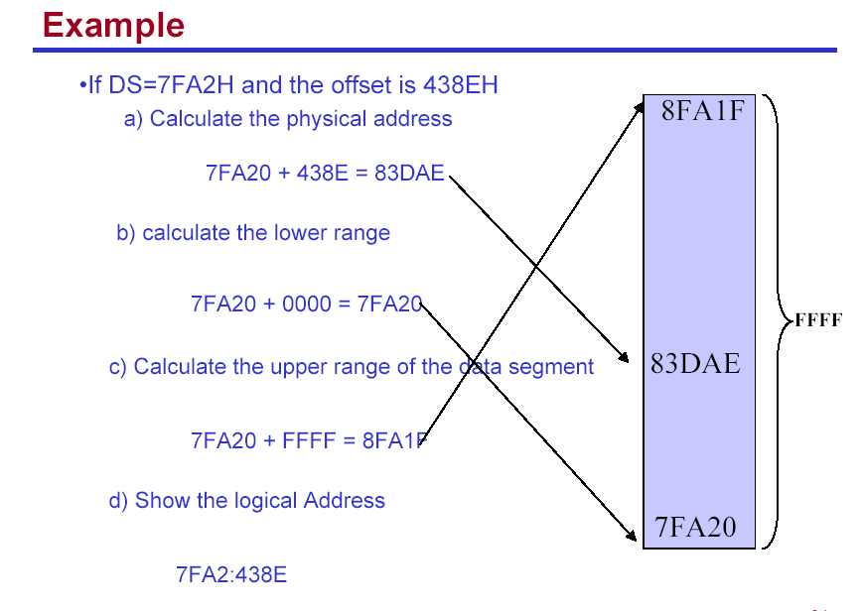

Slide 33
Your turn . . .
What linear address corresponds to the segment/offset address 028F:0030?
028F0 + 0030 = 02920
Always use hexadecimal notation for addresses.

Slide 34
The Code Segment
_{0H}
4000H
CS:
0400H
IP
0056H
4056H
CS:IP = 400:56
Logical Address
Memory
0400
0
Segment Register
Offset
Physical or
Absolute Address
+
0056
04056H
_{0FFFFFH}
The offset is the distance in bytes from the start of the segment.
The offset is given by the IP for the Code Segment.
Instructions are always fetched with using the CS register.
The physical address is also called the absolute address.

Slide 35
The Data Segment
_{0H}
05C00H
DS:
05C0
05C50H
EA
0050
DS:EA
Memory
05C0
0
Segment Register
Offset
Physical Address
+
0050
_{0FFFFFH}
05C50H
Data is usually fetched with respect to the DS register.
The effective address (EA) is the offset.
The EA depends on the addressing mode.

Slide 36
The Stack Segment
_{0H}
0A00
0A000H
SS:
0A100H
SP
0100
SS:SP
Memory
0A00
0
Segment Register
Offset
Physical Address
+
0100
0A100H
_{0FFFFFH}
The offset is given by the SP register.
The stack is always referenced with respect to the stack segment register.
The stack grows toward decreasing memory locations.
The SP points to the last or top item on the stack.
PUSH - pre-decrement the SP
POP - post-increment the SP

Slide 37


